Slide 1
Para hacer ahora
1) There are three types of verbs in Spanish. What are they?
2) How do you determine if a verb is an –ar, -er or –ir verb?
3) What steps do you follow to conjugate an –ar verb successfully?

Slide 2
Hoy es el siete de enero.

Slide 3
La cita del día

Slide 4
El objetivo
We are learning to conjugate –ar verbs in the present tense.

Slide 5
Un repaso
There are three types of verbs in Spanish:
AR Verbs
ER Verbs
IR Verbs
To figure out whether a verb is an –ar, -er or –ir verb, look at the last two letters of the infinitive:
Hablar → ar verb
Comer → er verb
Vivir → ir verb

Slide 6
Un repaso
We will begin our study of verbs by working with –ar verbs only.
Bailar
Hablar
Cantar
Estudiar
Necesitar

Slide 7
Un repaso
We follow the following steps to conjugate an –ar verb:
1) Drop off the letters “ar” from the infinitive:
Comprar
Comprar
Compr
2) Decide who is doing the action (yo, tú, él, ella, usted, nosotros, nosotras, ellos, ellas, ustedes)

Slide 8
Un repaso
3) Add the appropriate letter(s) onto the end of the infinitive:
Yo → o | Nosotros/nosotras → amos
Tú → as
Él/ella/usted → a | Ellos/ellas/ustedes → an

Slide 9
Más práctica
Let’s practice using the infinitive “comprar”.
The infinitive “comprar” means “to buy” in English.
In order to conjugate the verb, I will first drop the “ar” off of the infinitive leaving me with “compr”.
Next I will decide who is doing the buying and add the appropriate letters:
Yo compro Nosotros/nosotros compramos
Tú compras
Él/ella/usted compra Ellos/ellas/ustedes compran

Slide 10
Una lista de verbos

Slide 11
Más práctica
Yo | Nosotros/nosotras
Tú
Él//ella/usted | Ellos/ellas/ustedes

Slide 14
____________________________

Slide 15
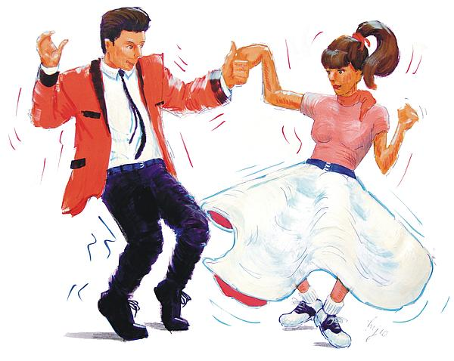
____________________________

Slide 16
____________________________

Slide 17
____________________________

Slide 18
____________________________

Slide 19
Más práctica

