Slide 1
Para hacer ahora
What is the difference between the subjects “Ella” and “Ellas”?
What is the difference between the subjects “Él” and Ellos”?
What is the difference between the subjects “Nosotros” and “Nosotras”?

Slide 2
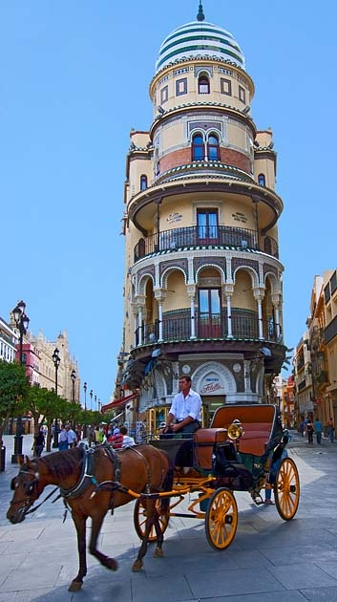
Hoy es el 28 de noviembre.

Slide 3
La cita del día

Slide 4
Un repaso
We learned five new subjects yesterday. They are:

Slide 5
Un repaso
The five new subjects we learned yesterday mean the following in English:
Nosotros →
Nosotras →
Ellos →
Ellas →
Ustedes →

Slide 6
Un repaso
The five new subjects we learned yesterday are conjugated as follows:
Nosotros
Nosotras
Ellos
Ellas
Ustedes

Slide 7
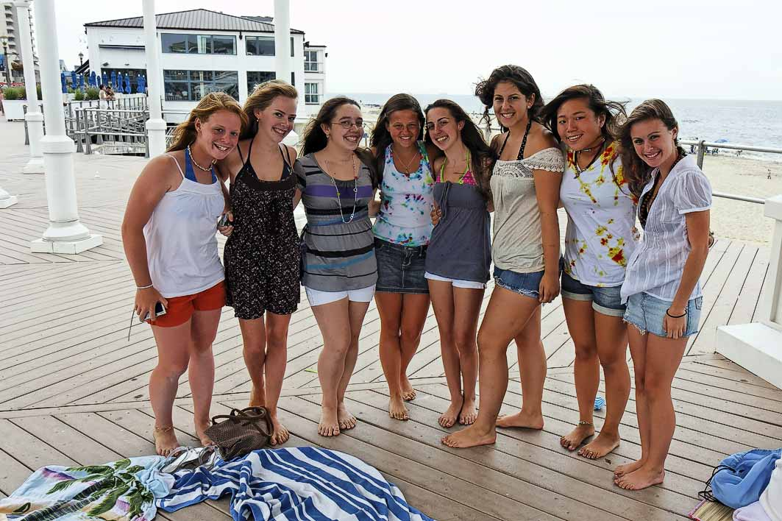
Describan la foto

Slide 8
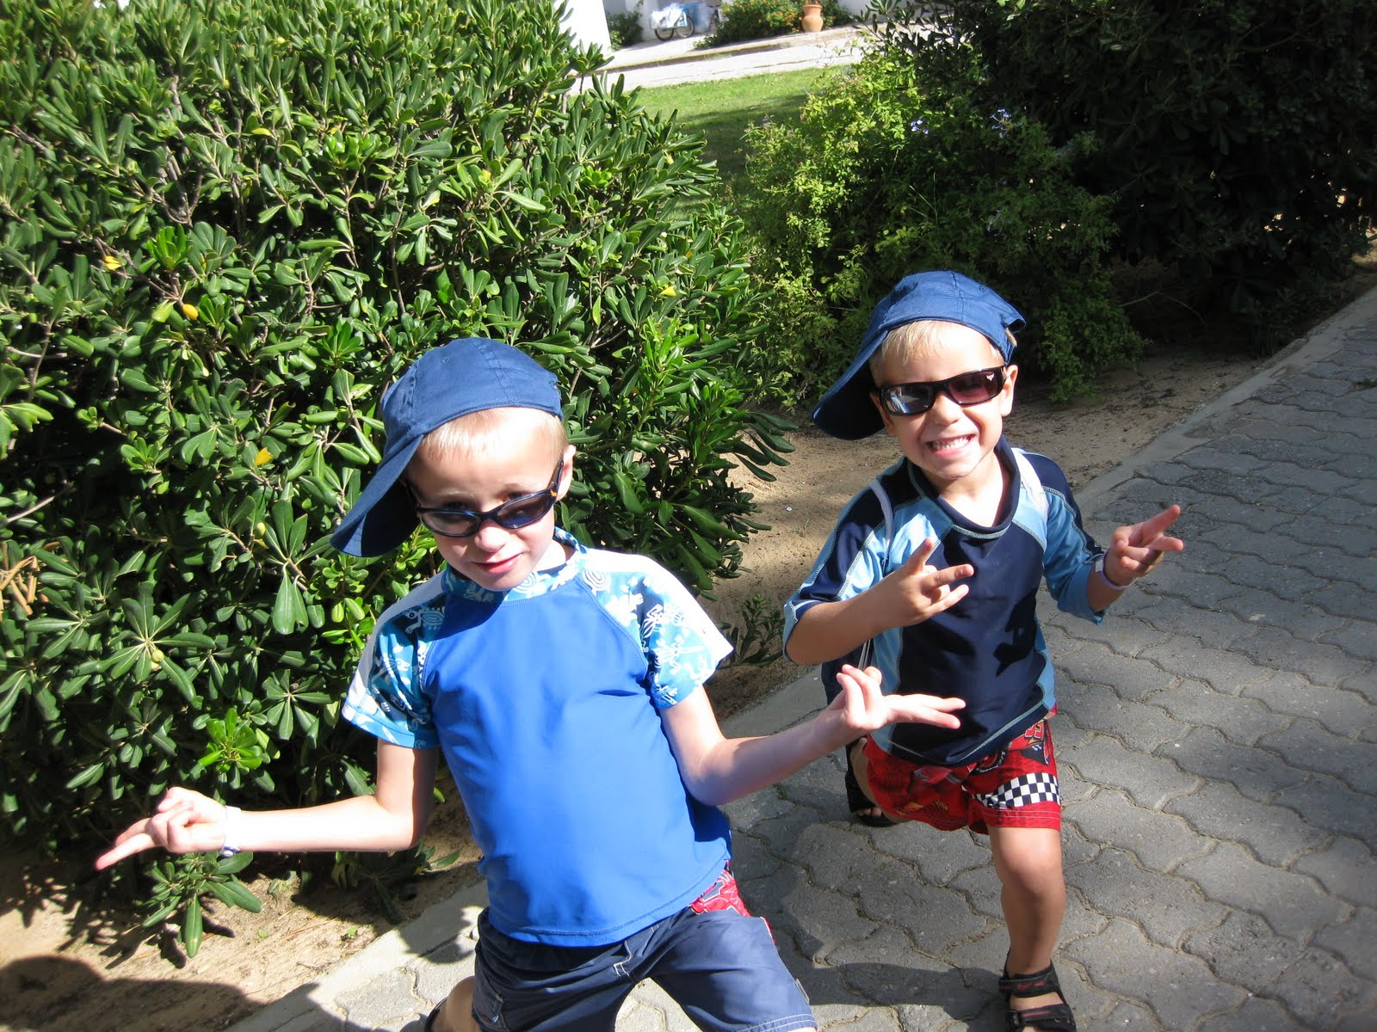
Describan la foto

Slide 9
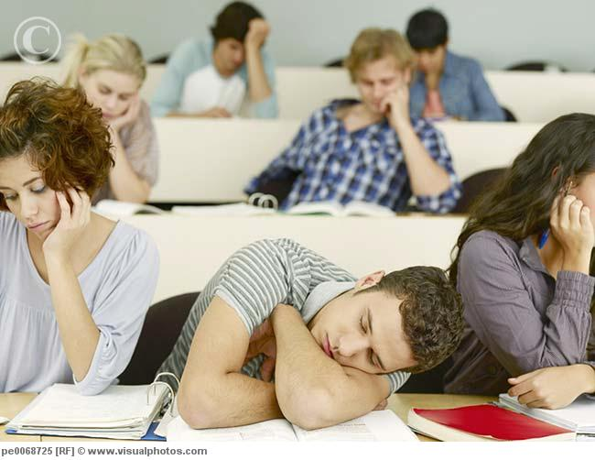
Describan la foto

Slide 10
Describan la foto
You are here

Slide 11
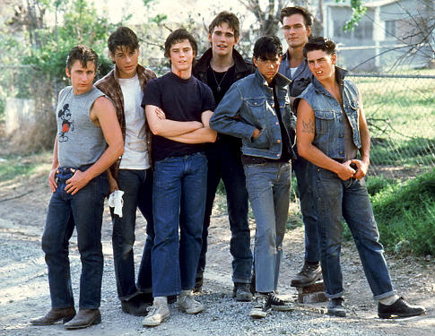
Describan la foto
You are here

Slide 12
Describan la foto
You are here

Slide 13
Traduzcan
1) Ellas son de España.
2) Nosotros somos muy serios.
3) Ustedes son inteligentes.
4) Nosotras somos guapas.
5) Ellos son alumnos en la escuela secundaria.

Slide 14
Traduzcan
1) We (a group of boys) are men.
2) You all are students in Belleville.
3) They (a group of boys) are from Mexico.
4) They (a group of boys and girls) are mexican.
5) We (a group of girls) are tall. We are also skinny.

