Slide 1
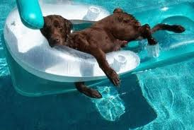
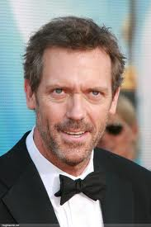
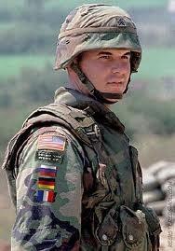
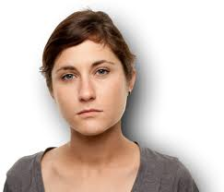
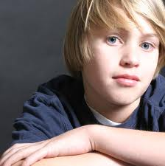
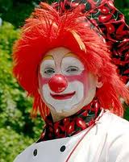
Para hacer ahora
¿Cómo es?
1) 4)
2) 5)
3) 6)

Slide 2
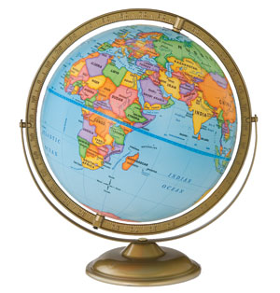
Hoy es el 9 de octubre.

Slide 3
La cita del día

Slide 4
Un repaso
Please take out your worksheets from last week.
We will be going over them as a class.

Slide 5
El mundo hispano
It is important to learn the geography of the Spanish speaking world as you learn the language and culture.
In Chapter 1, we learn how to express origin and nationality.
Being familiar with the maps of South and Central America will allow us to do this with greater ease.

Slide 6
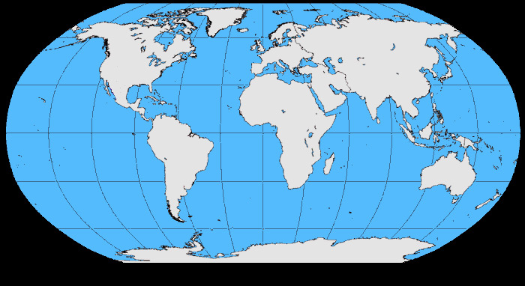

Slide 7
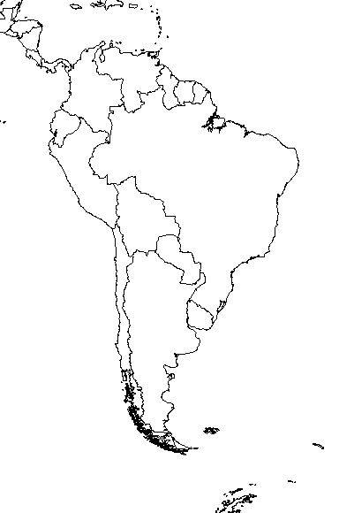

Slide 8
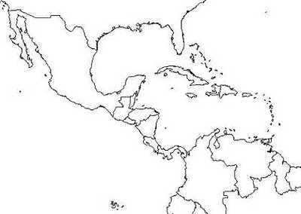

Slide 9
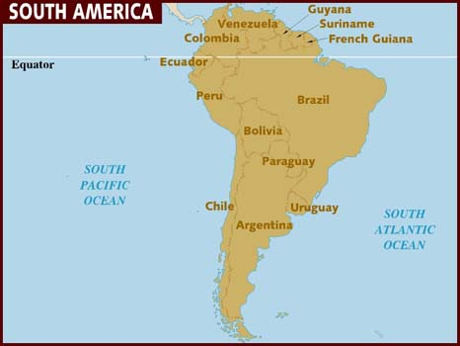

Slide 10
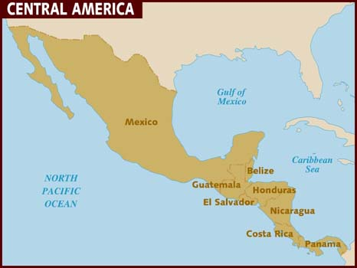

Slide 11
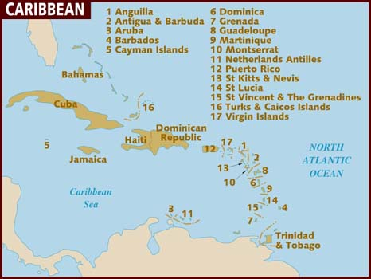

Slide 12
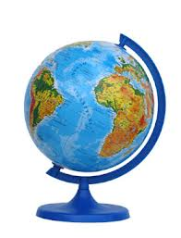
Los paises
LAS NACIONALIDADES

