Slide 1
Para hacer ahora
1) It is 8:00 at night. How would you greet someone in Spanish at this time?
2) It is 12:00 in the afternoon. How would you greet someone in Spanish at this time?
3) How would you ask someone 15 years old how they are feeling today?
4) How would you say goodbye to someone if you are planning on seeing them again tomorrow?
5) Which greeting can you use no matter what time of day it is? Which farewell can you use no matter what time of day it is?

Slide 2
Un repaso
Greetings:
Anytime:
Morning:
Afternoon:
Night:

Slide 3
Un repaso
How to ask someone how they are feeling today:
Someone your age/younger/ “on your level”:
Someone older than you/someone you want to show respect to:

Slide 4
Un repaso
Emotions:

Slide 5
Un repaso
Farewells:
Anytime:
If you will see them again soon:
If you will see them later:
If you will see them tomorrow:

Slide 6
Classroom Conversations

Slide 7
Hoy es el 12 de septiembre.

Slide 8
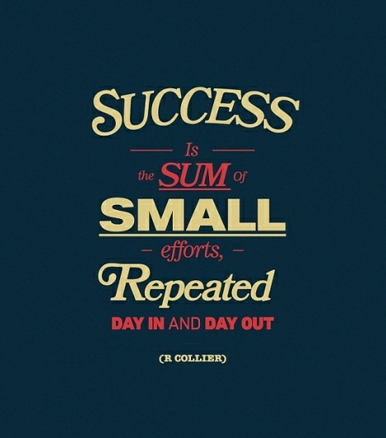
La cita del día

Slide 9
El objetivo
Each learner will demonstrate the ability to:
Ask someone else his/her name
State someone else’s name
State his/her own name

Slide 10
Asking someone else his/her name
If the person is your age, younger or on your “level”:
¿Cómo te llamas?
If the person is older than you and/or is someone to whom you would like to show respect:
¿Cómo se llama?

Slide 11
Más práctica How you would ask the following people their names?
1) Your classmate
2) Your teacher
3) Your principal
4) A child at a day care center
5) An elderly store clerk
6) Your sister/brother
7) A fifth grader

Slide 12
Más práctica How you would ask the following people their names?
1) Your boss
2) Your younger sister’s friend
3) A small child at a park
4) The governor of New Jersey
5) A man interviewing you for a job
6) A second grader
7) A guest speaker in our classroom

Slide 13
How to respond
Me llamo …

Slide 14
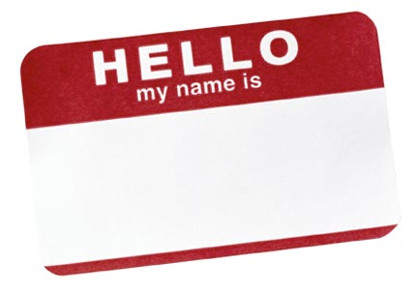
Por ejemplo
¿Cómo te llamas?
Me llamo José Castillo.
¿Cómo te llamas?
Me llamo Sara Rodríguez.
¿Cómo se llama?
Me llamo Miguel Montes.
¿Cómo se llama?
Me llamo María Ávila.

Slide 15
Vamos a
practicar

Slide 16
Más práctica
A five year old→ Michelle Obama
A teenage girl → A friend of a friend named Carly
A Spanish I student → Mr. Pineda
A principal → A new student named Carlos

Slide 17
Más práctica
1) A fifth grade student → Mr. Pagano
2) Miss Holland → Mrs. Cardona
3) Usher → Beyonce
4) An elementary school student → The president

Slide 18
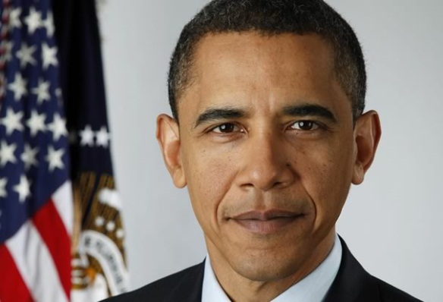
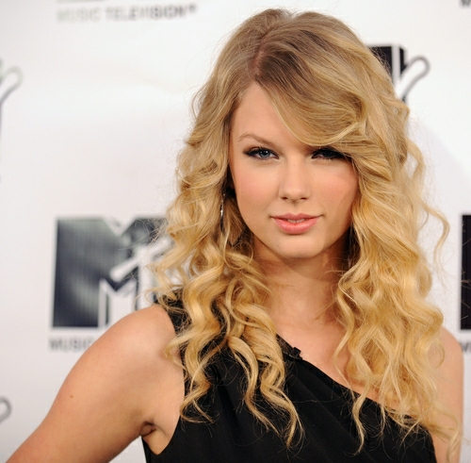
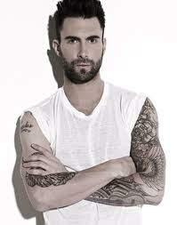
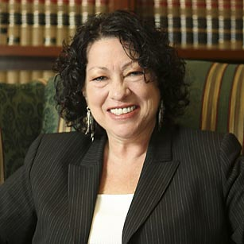
Stating someone else’s name
Él se llama ________________
Ella se llama _____________
Él se llama Barack Obama.
Él se llama Adam Levine.
Ella se llama Taylor Swift.
Ella se llama Sonia Sotomayor.

Slide 19
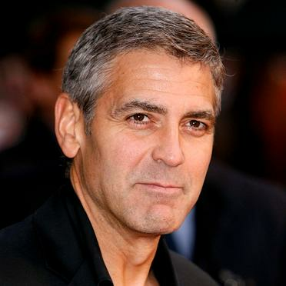
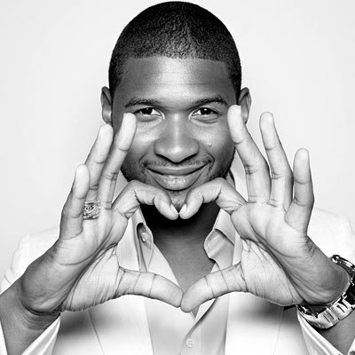
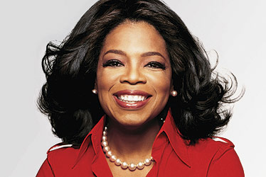
Más práctica State the name of each person below in a complete sentence

Slide 20
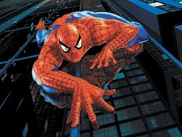
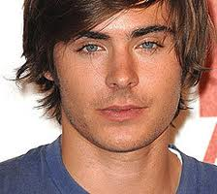
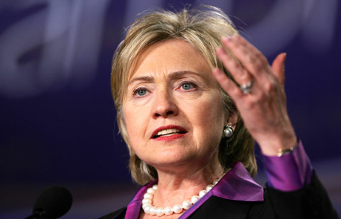
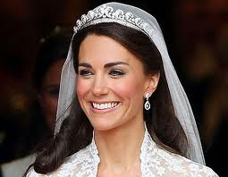
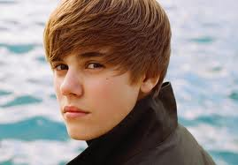
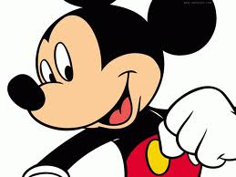
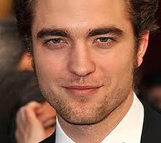
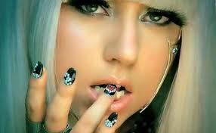
Más práctica State the name of each person below in a complete sentence

Slide 21
Nombre vs. Apellido
Nombre | Apellido
Wendy | Holland
Barrack | Obama
Oprah | Winfrey
Taylor | Swift
Kanye | West
Mi nombre es _____________.
Mi apellido es _____________.
Él se llama Adam Levine.

Slide 22
Un repaso

