Slide 1
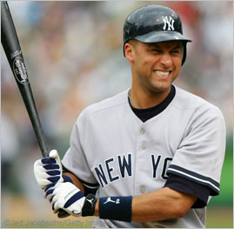
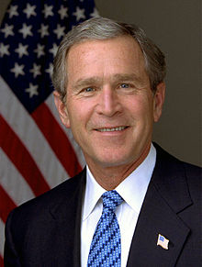
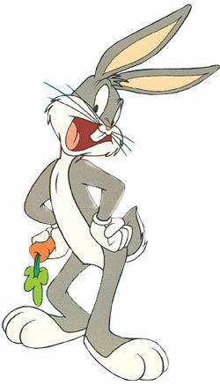
Para hacer ahora
#1) What is the difference between the terms “nombre” and “apellido”?
#2) ¿Cómo te llamas?
#3) State the names of the following people in complete sentences:

Slide 2
Un repaso
How can you state your first name?
How can you state someone else’s name?

Slide 3
Un repaso
What is the difference between the following questions:
¿Cómo te llamas?
¿Cómo se llama?

Slide 4
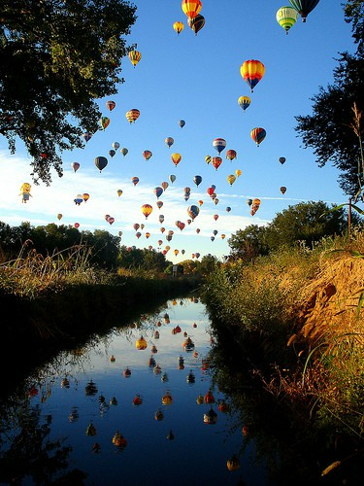
Hoy es el 13 de septiembre.

Slide 5
La cita del día

Slide 6
El objetivo
All learners will demonstrate the ability to practice recently explored skills:
Basic conversations
Stating one’s name
Asking one’s name
Stating someone else’s name

Slide 7
Actividad #1
Each pair will receive a pack of vocabulary words and three headings:
Los saludos
Las emociones
Las despedidas
When the teacher says go, each pair will work as a team to put the vocabulary words under the correct headings.
When completed, each pair will put the green cup facing up on their desks and work on their word search.

Slide 8
Actividad #2
Each pair will receive a pack of sentence strips.
When the teacher says go, each pair will work as a team to put the sentence strips in the correct order.
When completed, each pair will put the green cup facing up on their desks and work on their word search.

Slide 9
Actividad #3
Each pair will recieve a pack of photographs, first names, last names and the headings “nombres”, “apellidos”, and “fotos”.
When the teacher says go, each pair will work as a team to put the photographs next to the correct “nombre” and “apellido”.
When completed, each pair will put the green cup facing up on their desks and work on their word search.

